Slide 1
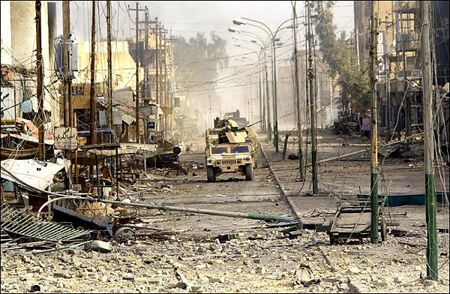



Title Slide
OPERATION AL FAJR
(PHANTOM FURY)
Fallujah
November 2004
United States Army Combined Arms Center

Slide 2
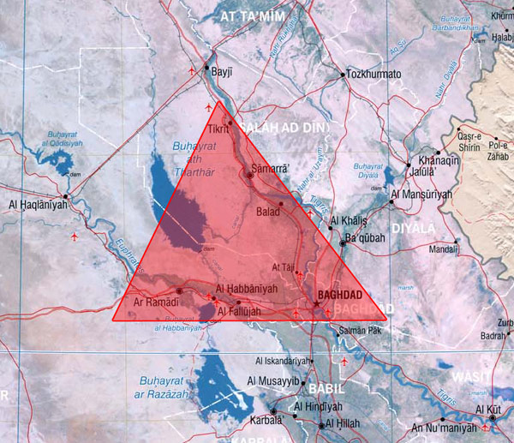

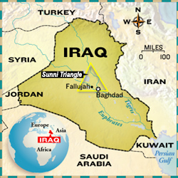
Sunni Triangle
2

Slide 3
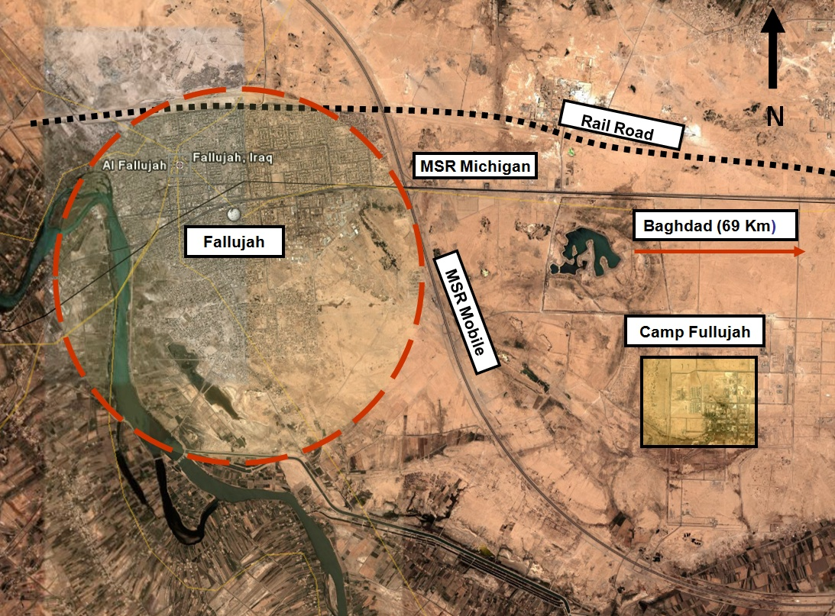

Fallujah Environs
Garma
Baghdad
Camp Baharia
3
Fallujah is approx. 3.2 km E-W and 4 km N-S

Slide 4
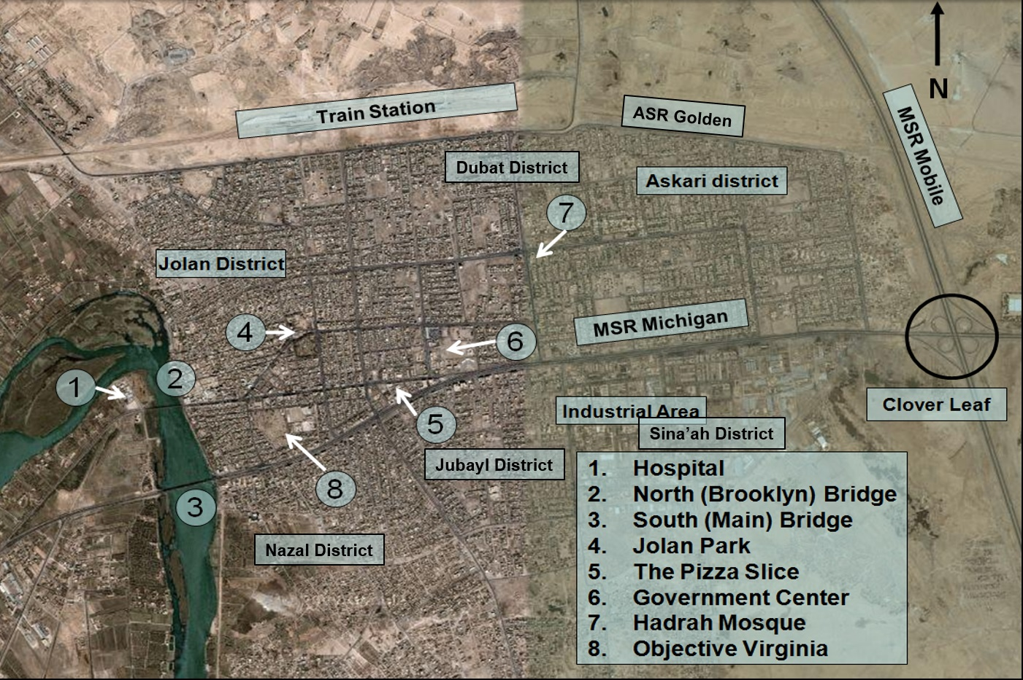
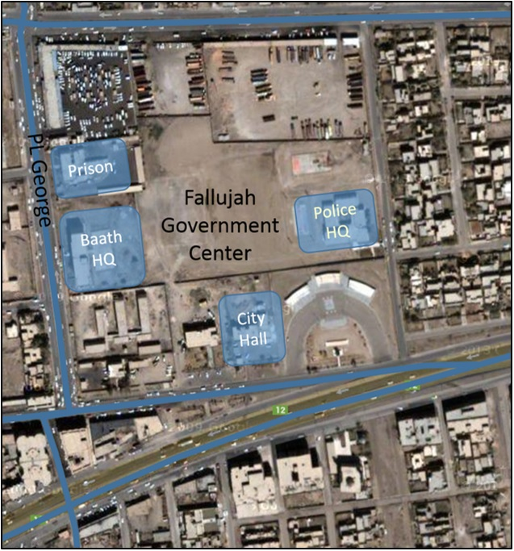
Fallujah Key Terrain
4

Slide 5
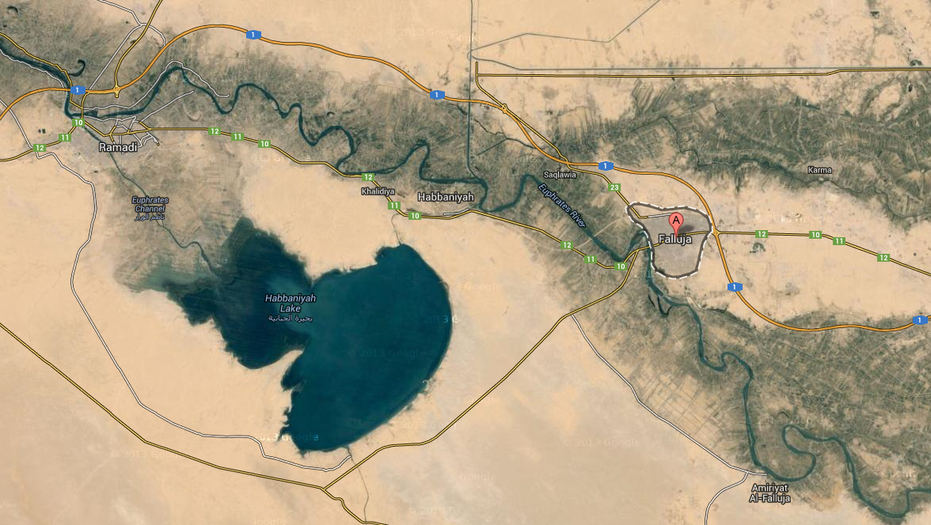

Fallujah Area Tribes
Khalifa
1st Mar Div
Falahar
Mohembdi
~32 miles
Jumayli
Alwan
Lahib
Halbusa
Taqaddum
Airfield
Camp
Fallujah
Issa
Zobai
5

Slide 6

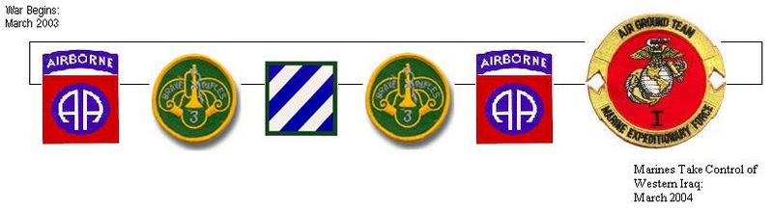



Fallujah: April 2003 – March 2004
Unit | April 2003 | May | June | July | August | Sep 2003- Jan 2004 | February | March
28 April (Saddam’s birthday): 17 Iraqis killed in protest
2 Nov: CH-47 shot down north of Fallujah
13 Jan 04: Operation Market Sweep –Raid for arms in downtown Fallujah market
3 Dec 03 – Saddam Hussein Captured
24 Mar: 1st Marine Division assumes AO
31 Mar: 4 Blackwater contractors killed
(Insurgency) grows
Forces remain mostly outside the city
6

Slide 7
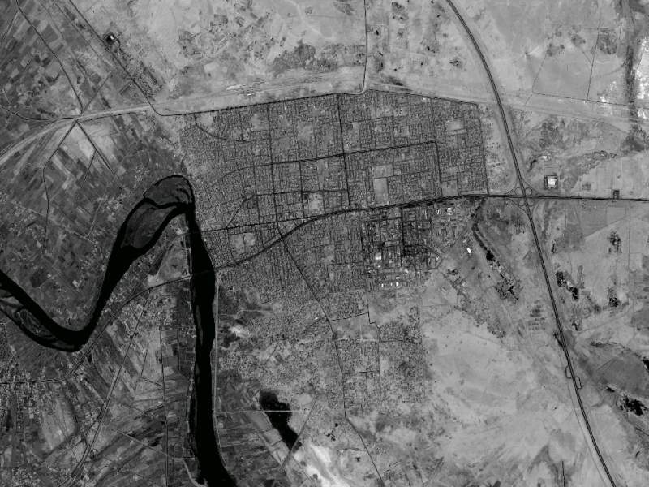
Operation Vigilant Resolve
Initiate attack
on 5 April
I I
2
1
I I
3/4 joined the fight on 8 April
3
4
Combat Ineffective
Never joined
2
IAF
I I
I I
1
5
2
2
Initiate attack
on 5 April
2/2 reinforced operation on 24 April
7
N

Slide 8



Fallujah: April 2004 – November 2004
Unit | April 2004 | May | June | July | August | September | October | November
4-24 Apr: VIGILANT RESOLVE
7 Nov: AL FAJR Begins
28 Jun 04: IIG Sovereignty
28 Apr - Sep: Fallujah Brigade “responsible” for the city
OPCON:
TF 2-2 IN TF 2-7 Cav
5 Aug – 3 Sep: Battle of Najaf
29 Apr: Abu Ghraib story breaks
10 Sep: I MEF directed to plan a new attack on Fallujah
Sadr Uprising (Baghdad, Najaf, Al Kut)
7 May: Zarqawi decapitates Nicholas Berg
US Forces remain mostly outside the city
8

Slide 9
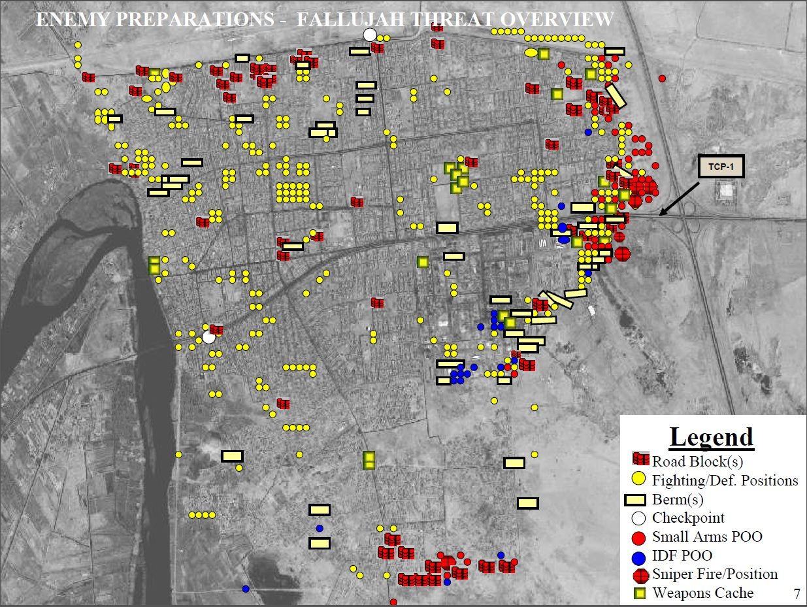
Fallujah Defensive Preparations
Hadrah Mosque
Government Center
Jolan Park
Hospital
Obj. Virginia
9

Slide 10


I MEF Task Organization
Fallujah
Fallujah
Environs
Ramadi
Western
AO
N. Babil
I I I
(-)(Rein)
I I I
(-)(Rein)
x
(Rein)
x
(Rein)
I I I
I I I
x
1
(Rein)
7
2
1
2
2
31
24
I I
I I
(Rein)
(Rein)
(Rein)
I I
1
3
5
I I
I I
IIF
1
8
2
12
1
503
1
23
1
2
(Rein)
SSF
I I
I I
I
I I
(-)
3
1
SSF
1
3
A
3
1
5
1
506
I
(Rein)
SSF
SSF
I I
(-)
I
I I
(-)(Rein)
I I
(Rein)
M
14
MP
2
I I
I I
2
2
759
5
I
SSF
C
2
1
7
24
(-)(Rein)
(-)
I
(-)
I
I
(-)
B
2
I I
I I
(-)
C
2
A
2
C
12
2
SSF
118
MP
I
(-)(Rein)
SSF
scc
I I
I
I I
(-)
3
C
2
SEAL
C
1
9
1-4
ANGLICO
SSF
S
10
1
I
I
I
I I
2
7
E
44
5
3
B
5-5
E
ACE
IAF
A
2
I
44
2
1
(-)
E
AZERBAIJAN
BLACK WATCH
ACE
1
44
DIV RESERVE
FORCE
2
B
4
(Rein)
SEAL
A
IIF
I I
SEAL
B
1-4
A
3-82
2
6
3
24
IAF
1
IIF
1
4
1
GEN. SUPPORT
IIF
I I
I
2
MP
11
10
ING
36
CDO

Slide 11

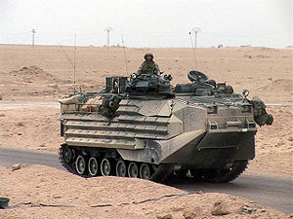
Task Organization 3rd Bn, 5th Mar
(Rein)
I I
3
5
Attached
I
I
I
I
I
SSF
I
5
K
5
L
5
WPNS
3/5
H&S
3/5
Sniper Plt
Supply
Maint
Med
Comms
1
1
1
2
2
2
3
3
3
27 x Rifle Squads
18 x M240s
6 x .50 cal/40mm
9 x 60 mm mortars
8 x 81 mm mortars
8 x TOW platforms
12 x Javelin
Wpns
Wpns
Wpns
11

Slide 12

Task Organization TF 2-2 IN
I I
2
2
I
I
I
I I
I
A
2-2
A
2-63
F
4
2 IIF
HHC
2-2
I
1 2 BN IIF
I
2 2 BN IIF
SCTS
2-2 IN
SPT
E
14 x M1A1s
16 x M2A2s
8 x Rifle Squads
2 x ACEs
2 x D9s
1 x MCLIC
12

Slide 13

Task Organization TF 2-7 CAV
I I
2-7
I
I
(-)
I
I
I
A
2-7
C
2-7
C
3-8
B
FSC
215
HHC
2-7
1
A/2-7
1
C/2-7
1
C/3-8
SPT
SPT
B/215
2
L
B/2-162
2
A/2-7
3
C/2-7
2
C/3-8
Maint
B/215
HHC/2-7
3
C/3-8
2
C/2-7
HHC/2-7
HHC/2-7
14 x M1A2s
30 x M2A3s
12 x Rifle Squads
13

Slide 14
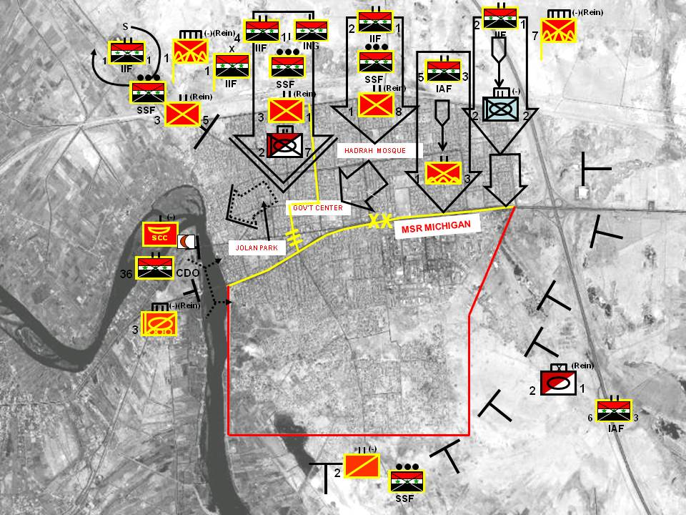
Plan For Phase III: Decisive Operations
ME: RCT 1 (-)(REIN)
AT A-HOUR (1900L) ON D+1, CONDUCT PENETRATION IN ZONE
CONTINUE ATTACK TO SECURE JOLAN DISTRICT
SE1: RCT-7 (-)(REIN)
AT A-HOUR, CONDUCT PENETRATION IN ZONE TO SEIZE HADRAH MOSQUE & GOV’T CENTER
SECURE MSR MICHIGAN IN ZONE
SE2: BLACK JACK BDE
INTERDICT INSURGENTS IN AO RALEIGH
BLOCK SOUTH/SOUTHEAST OF FALLUJAH
SECURITY OF SR MOBILE & MICHIGAN IN ZONE
14

Slide 15
Maneuver Control Measures
PL Ethan
PL Dave
PL Charles
PL Frank
PL George
PL Bill
PL Isaac
PL Henry
PL Abe
PL Jacob
PL April
PL Beth
PL Cathy
PL Donna
PL Fran
PL Elizabeth
PL Fran
PL Grace
PL Heather
PL Isabella
Each house was numbered.
All tactical commanders operated off of a common map.
PL Jenna
PL Katherine
15

Slide 16
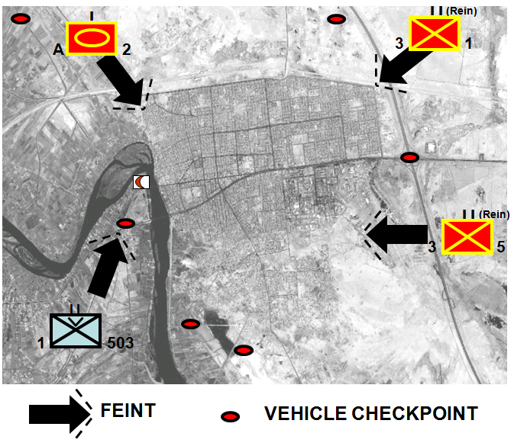
Phase I: Shaping Operations
Feints
Raids
Cordon and searches
Vehicle checkpoints (VCPs)
Indirect fires and CAS
Information OP and PSYOP
Targeting of AIF leadership
Special operations forces targeting
of high-value targets
DESIRED ENEMY END STATE
Confused as to MNF intentions
Wedge driven between populace
and AIF
C² nodes exposed and destroyed
Defenses identified
Heightened state of paranoia and
anxiety
(Rein)
I
I I
A
2
3
1
(Rein)
I I
3
5
I I
1
503
FEINT
VEHICLE CHECKPOINT
11
16

Slide 17
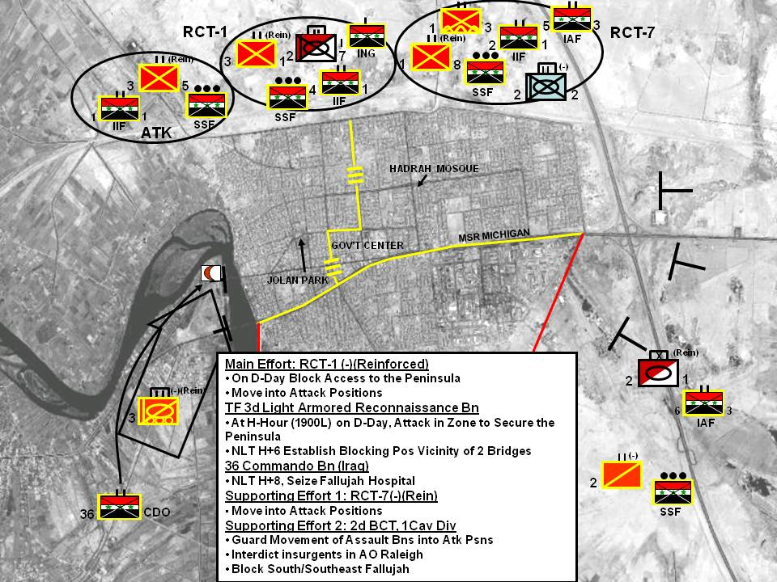
Phase II: Enhanced Shaping Operations
17

Slide 18
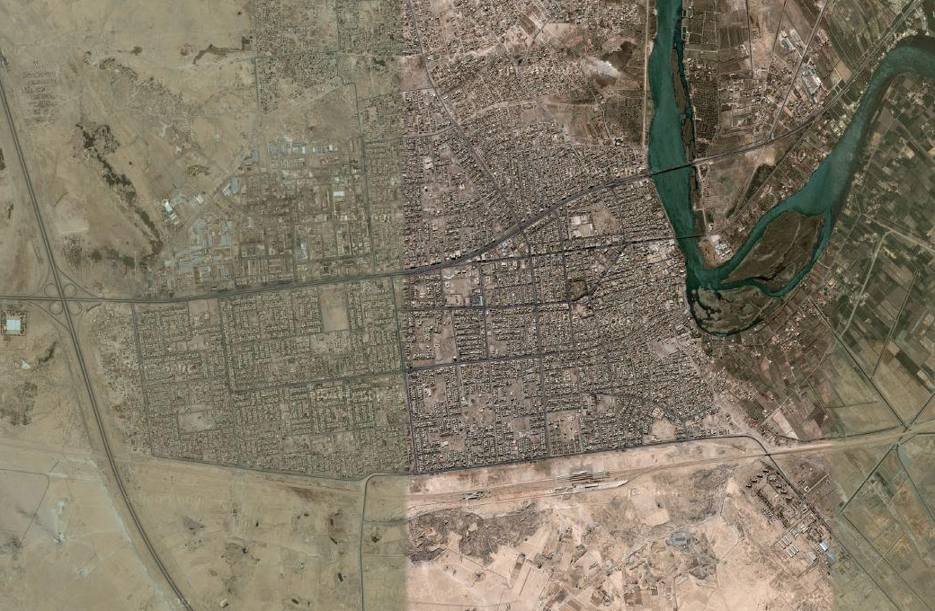
Phase IIIA: RCT-7 Assault
6
3
x
IAF
(Rein)
2
1
I I
(-)(Rein)
3
36
CDO
PL FRAN
(Rein)
I I
Gov’t
Center
I I
LOA
10 Nov, PM
1
8
LOA
091410 Nov
I I
(-)
101200
Nov
1
3
2
2
III
7 RCT
PL HENRY
090900
Nov
1 RCT
I I
(-)
OBJ
COYOTE
082328 Nov
2
2
I I
OBJ LION
081925 Nov
(Rein)
1
3
I I
OBJ
LEOPARD
082013 Nov
082351
Nov
1
8
(Rein)
I I
3
5
I I
(-)
(Rein)
I I
I I
(Rein)
I I
2
2
I I
1
3
1
8
3
1
2
7
18

Slide 19
Phase IIIA: RCT-1 Assault
6
3
x
IAF
(Rein)
2
1
I I
(-)(Rein)
3
36
CDO
PL FRAN
(Rein)
I I
Gov’t
Center
I I
LOA
10 Nov, PM
1
8
LOA
091410 Nov
I I
(-)
101200
Nov
1
3
2
2
III
PL HENRY
7 RCT
1 RCT
OBJ
COYOTE
082328 Nov
090900
Nov
OBJ LION
081925 Nov
082351
Nov
081930 Nov
OBJ
LEOPARD
082013 Nov
(Rein)
(Rein)
I I
090130
Nov
I I
3
1
3
5
081900-2034 Nov
(Rein)
I I
I I
3
1
2
7
19

Slide 20
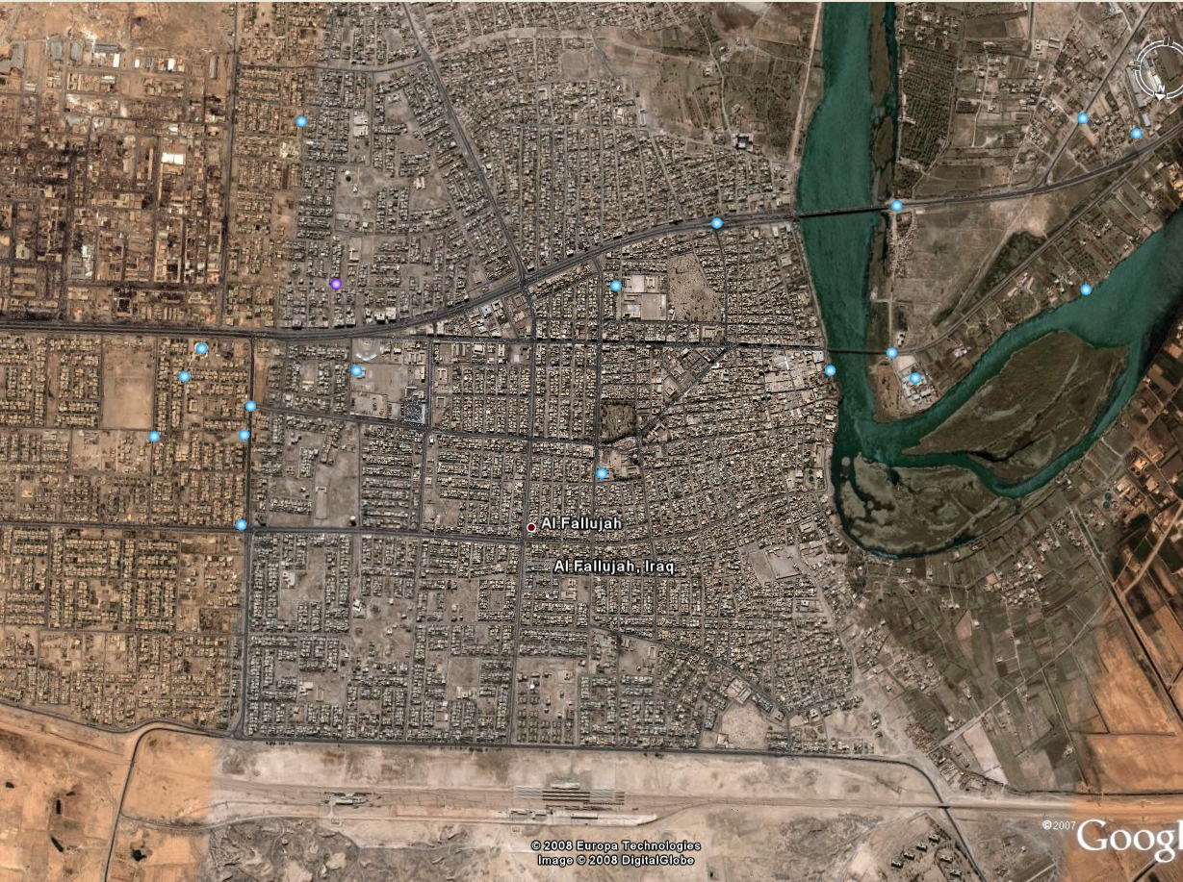

RCT 1 Attack, 8-9 Nov 04
I I
(-)(Rein)
3
PL FRAN
(Rein)
OBJ VIRGINIA
36
CDO
I I
1
8
101200
Nov
I
LOA Dawn, 09 Nov
I
A
2-7
Jolan Park
C
3-8
091230 Nov
I I I
PL HENRY
(Rein)
I I
7 RCT
1 RCT
(Rein)
1
8
I
I I
090900
Nov
C
3
1
I
3-8
I
C
2-7
A
2-7
(Rein)
(Rein)
I I
I I
3
1
3
5
I
C
2-7
Train Station
20

Slide 21
RCT-1 Attack, 9-10 Nov 04
I I
(-)(Rein)
3
PL FRAN
100900
Nov
(Rein)
OBJ VIRGINIA
36
CDO
I I
1
8
092330
Nov
101200
Nov
I
I
(Rein)
LOA Dawn, 09 Nov
A
2-7
I I
C
3-8
3
1
I I I
PL HENRY
091230 Nov
(Rein)
I I
7 RCT
1 RCT
1
8
(Rein)
I I
090900
Nov
3
5
I
C
2-7
Train Station
21

Slide 22
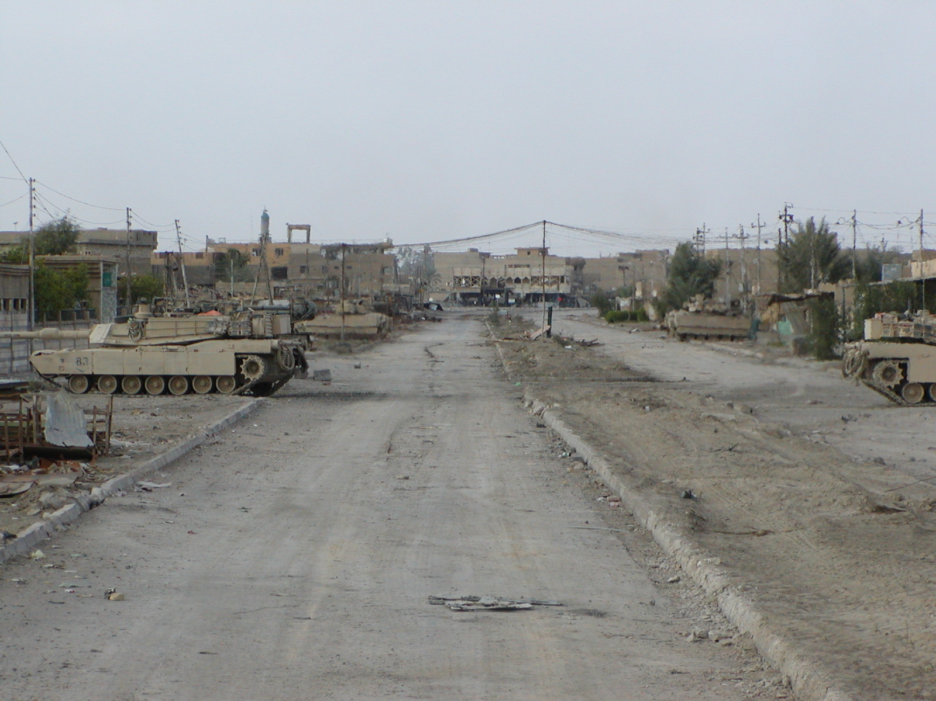
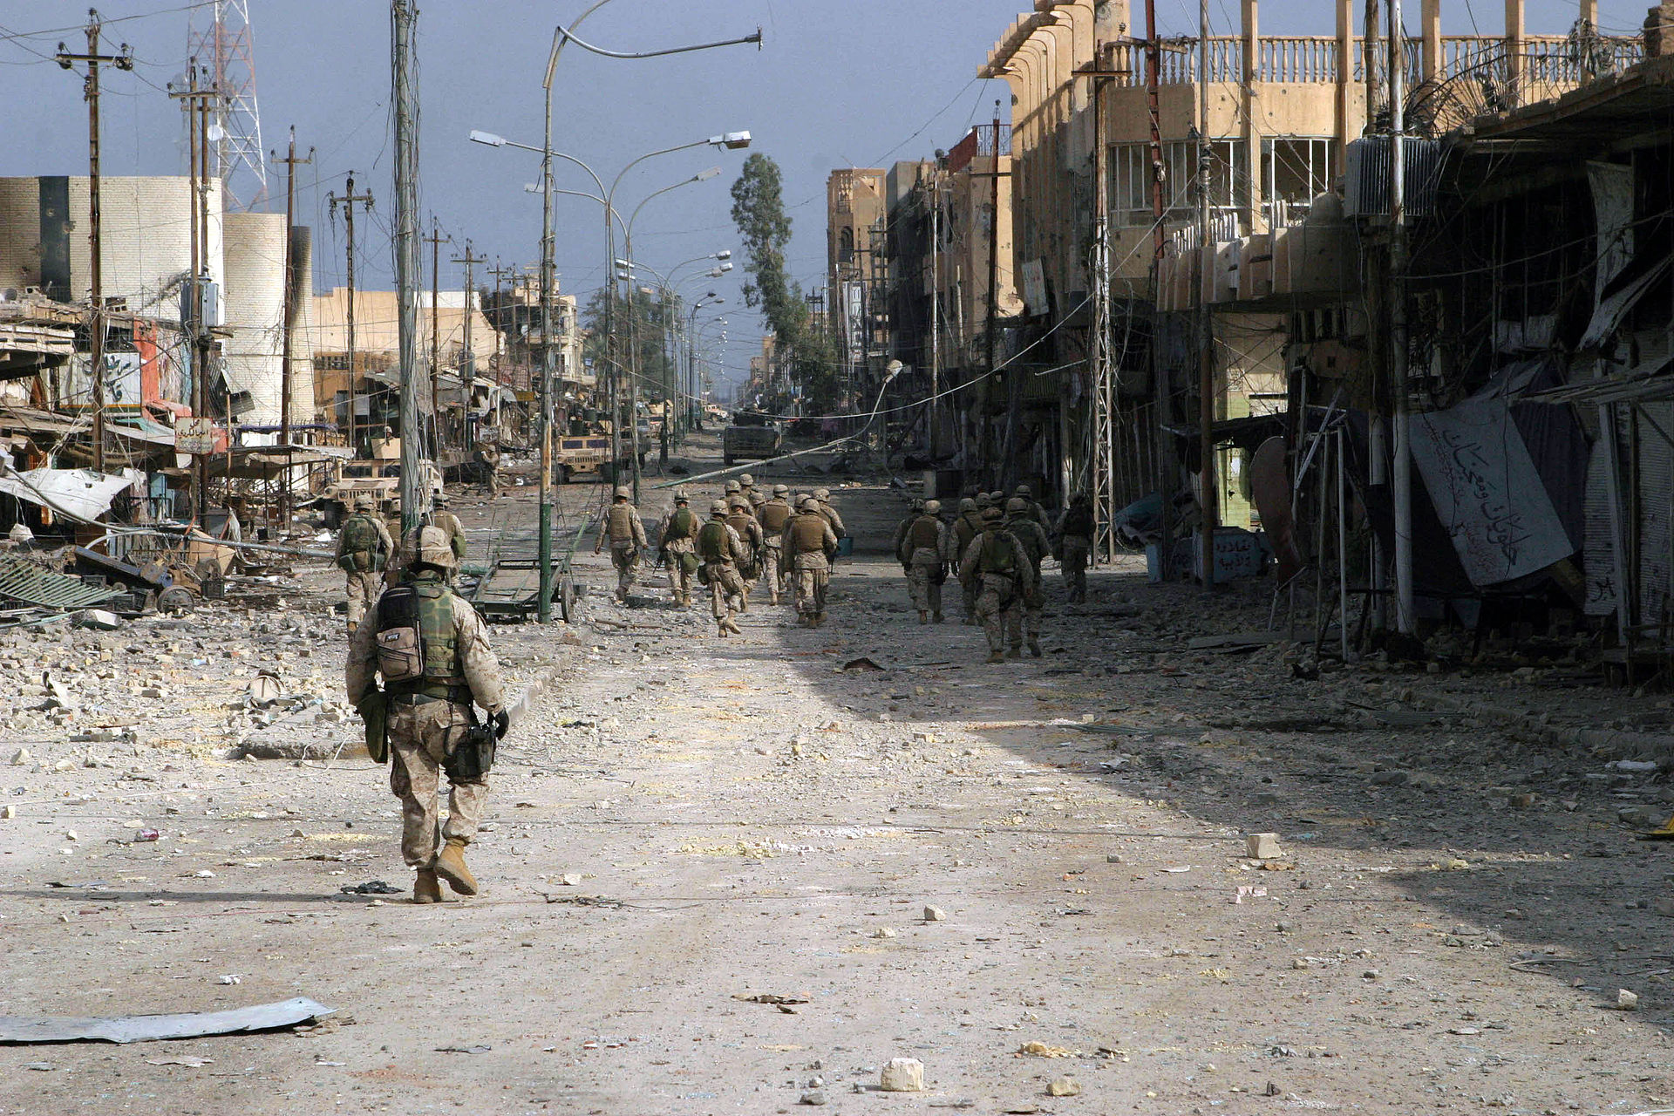
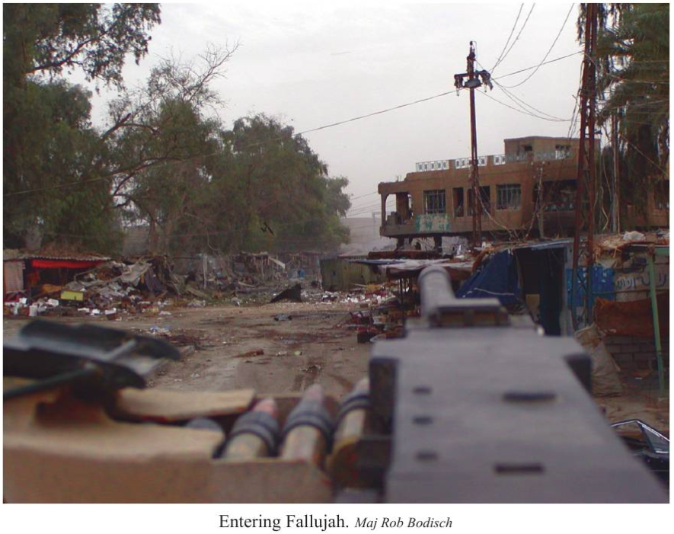
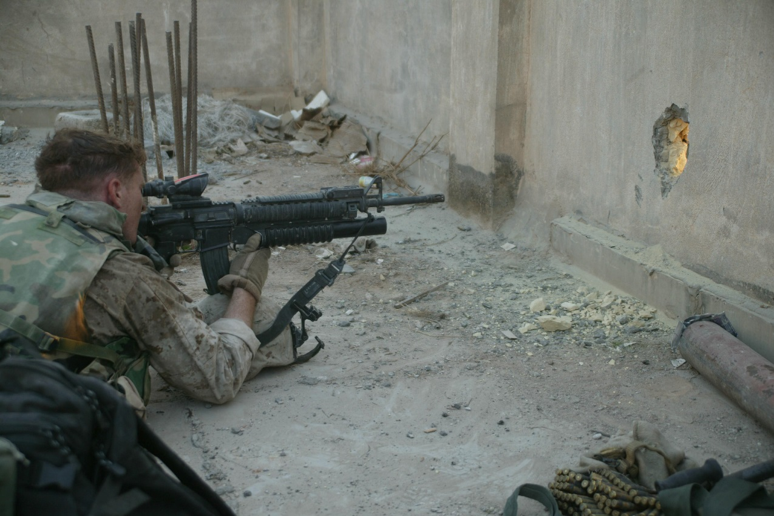
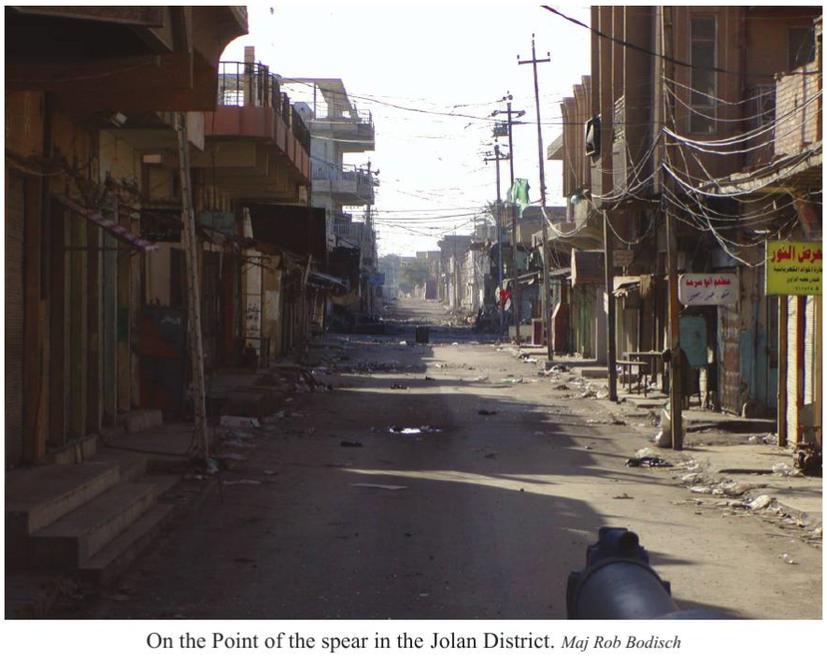
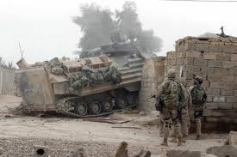
Fighting Inside Fallujah
Urban Combat Clips
22

Slide 23
1 Mar Div Disposition, Night of 10 Nov
6
3
x
IAF
(Rein)
2
1
I I
(-)(Rein)
3
I I
36
CDO
2
7
(Rein)
PL FRAN
I I
(Rein)
I I
1
1
8
3
I I
(Rein)
I I
I I
(-)
1
3
3
5
2
2
III
PL HENRY
7 RCT
1 RCT
23

Slide 24
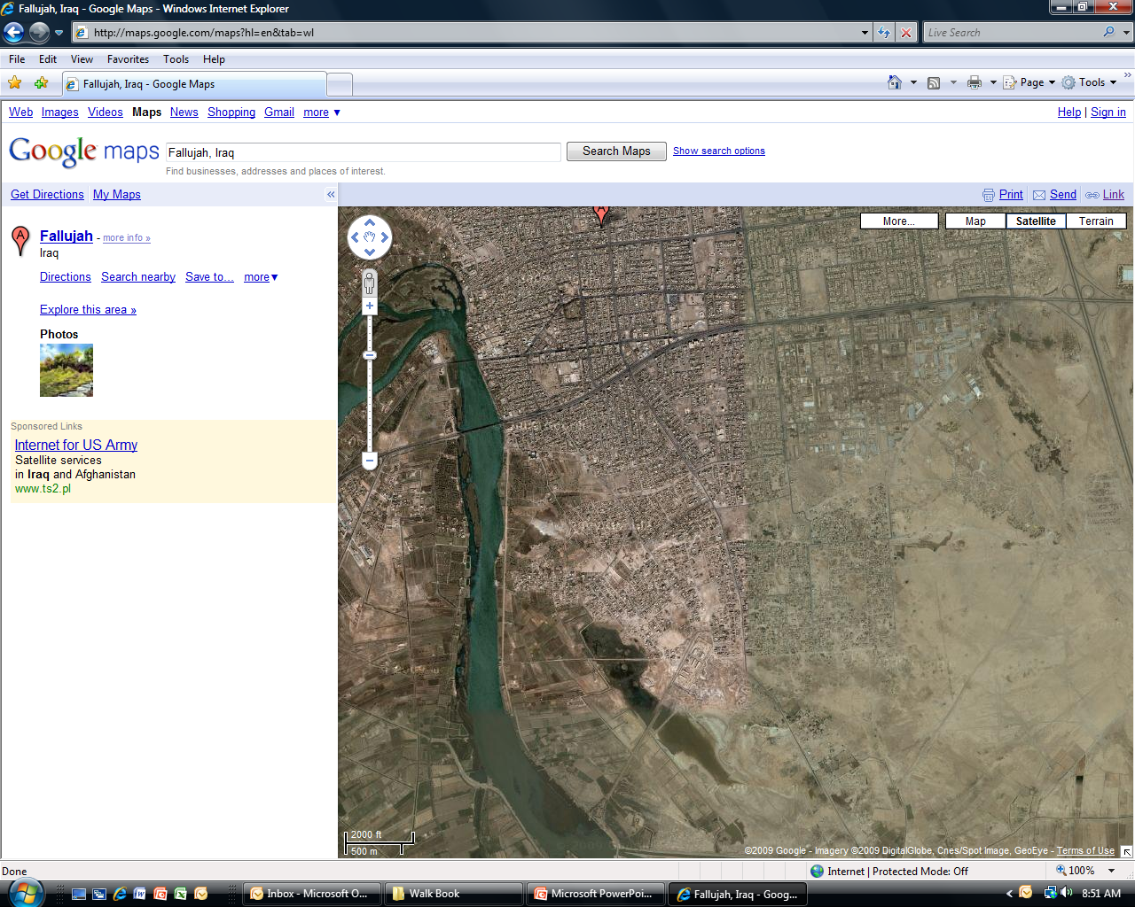
Phase IIIB South of PL FRAN 11-20 Nov 04
Revise!
PL JENNA
PL ISABELLA
I I I
I
I
A
2-7
(Rein)
C
3-8
I I
3
1
I
(Rein)
C
2-7
I I
(Rein)
I I
(-)
PL FRAN
1
8
I I
2
2
3
5
24

Slide 25
Phase IIIB South of PL FRAN 11-20 Nov 04
Revise!
PL JENNA
PL ISABELLA
I I I
I
I
A
2-7
(Rein)
C
3-8
I I
3
1
I
(Rein)
C
2-7
I I
(Rein)
I I
(-)
PL FRAN
1
8
I I
2
2
3
5
25

Slide 26
Phase IIIB South of PL FRAN 11-20 Nov 04
PL JENNA
PL ISABELLA
I I I
I I
(-)
I
2
2
(Rein)
I
I I
C
3-8
1
8
A
2-7
(Rein)
I I
3
1
I
N
C
2-7
(Rein)
PL FRAN
I I
3
5
26

Slide 27
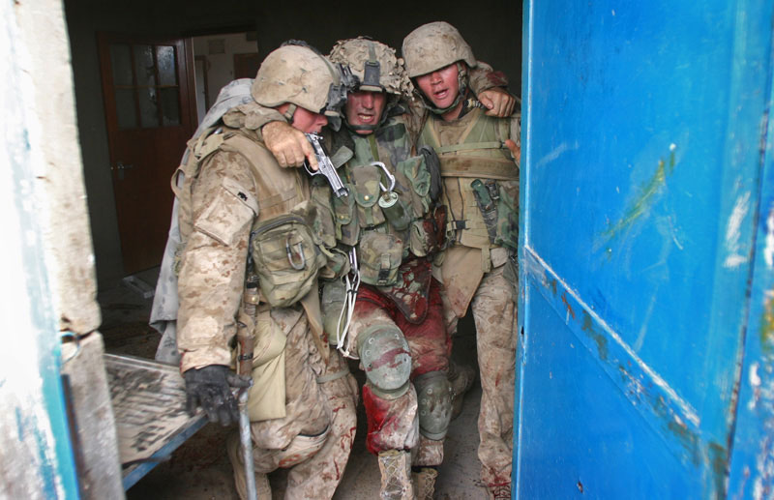
MSG Kasal at Hell House
27

Slide 28
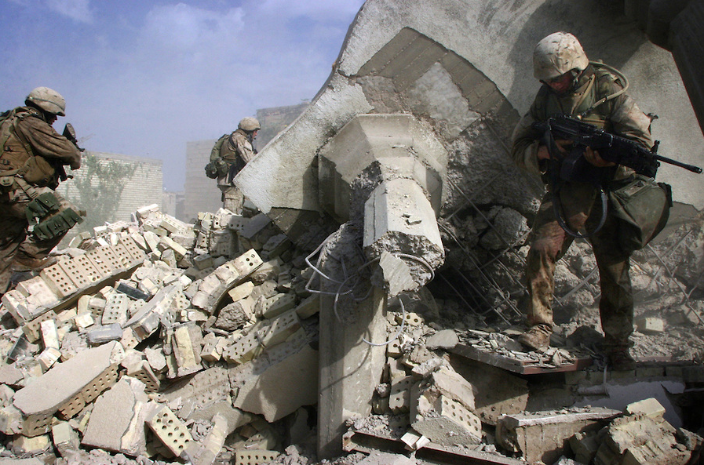
Outside of the Hell House
28

Slide 29
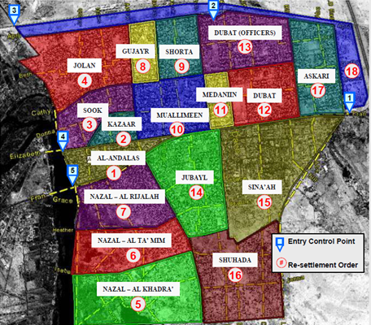
Phase IV & V- Transition
DUBAT (OFFICERS)
GUJAYR
SHORTA
JOLAN
ASKARI
MEDANIIN
DUBAT
SOOK
MUALLIMEEN
KAZAAR
AL- ANDALAS
JUBAYL
SINA’AH
NAZAL- AL RIJALAH
NAZAL- AL TA’MIM
SHUHADA
NAZAL- AL KHADRA’
29

Slide 30
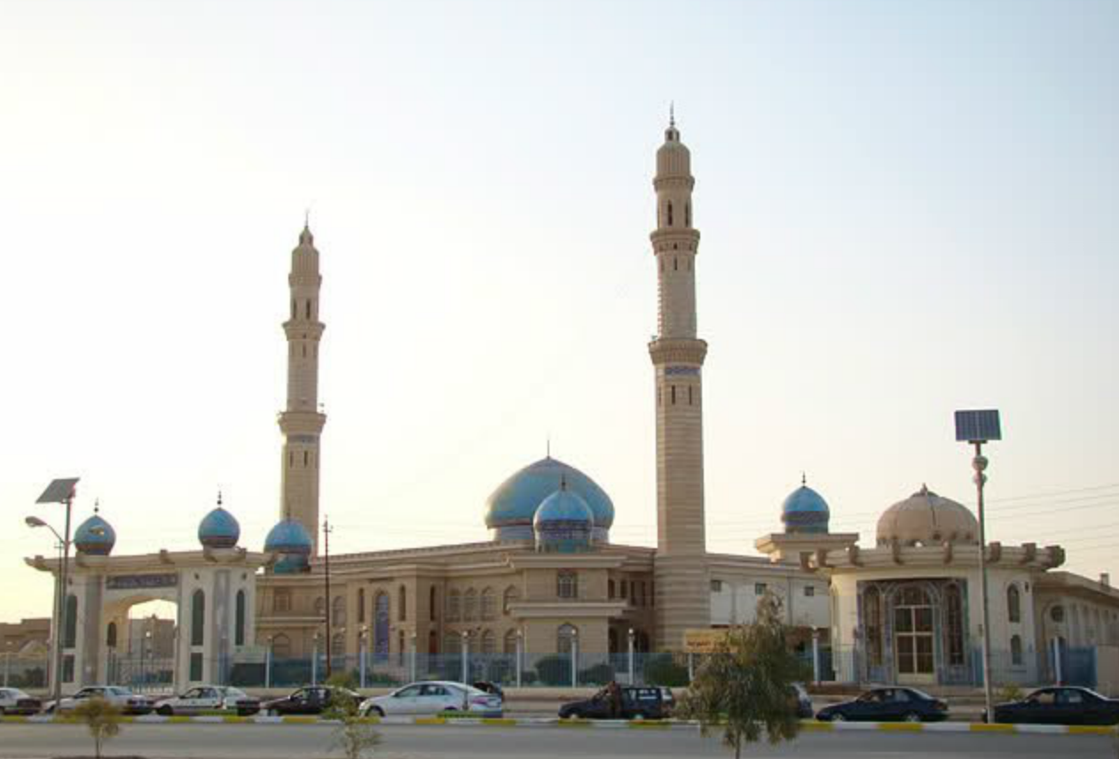
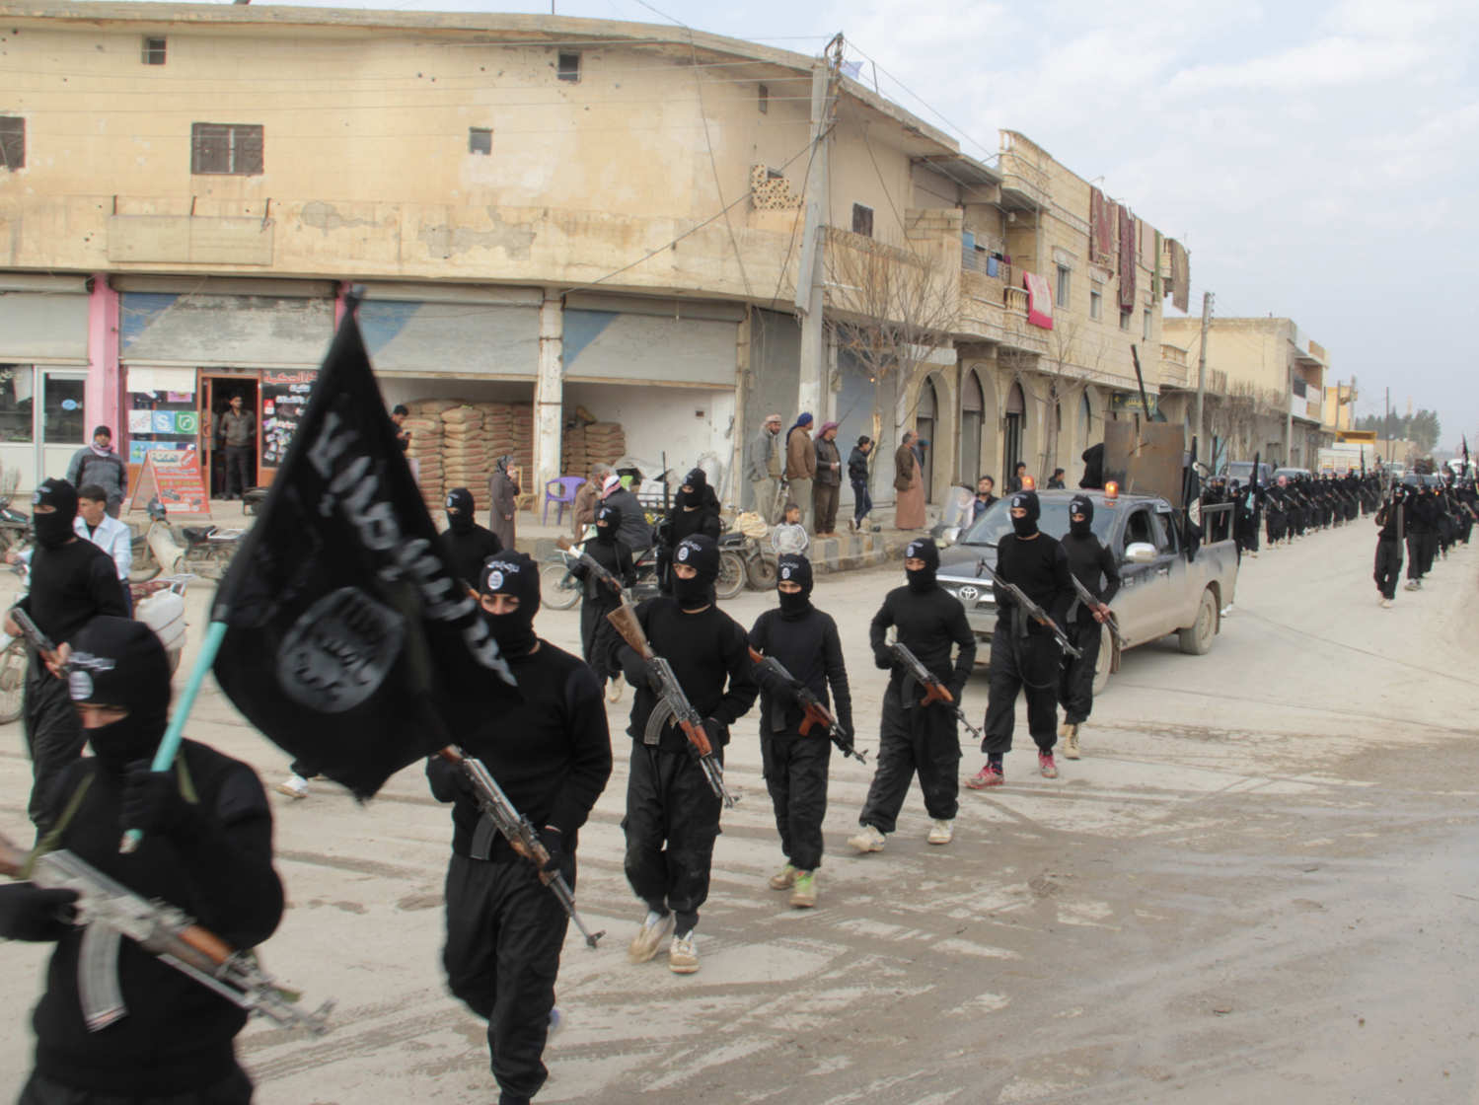
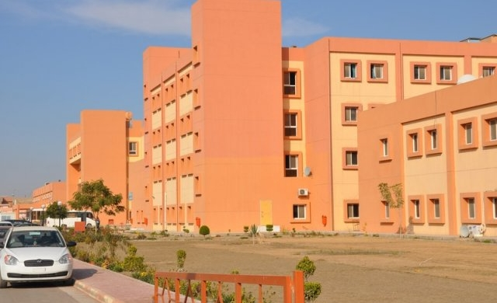
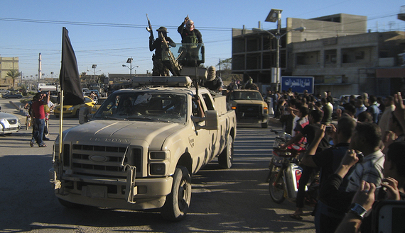
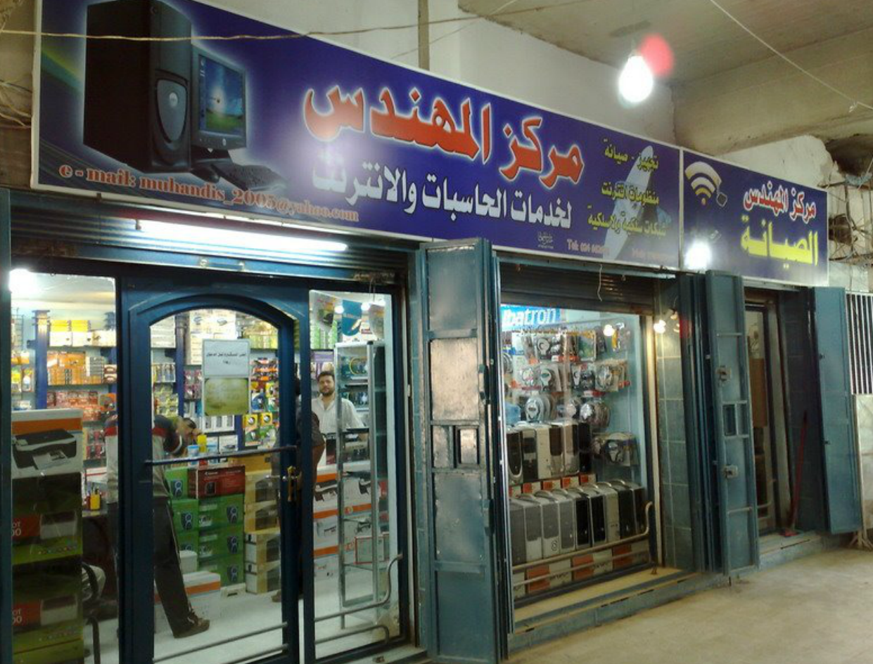
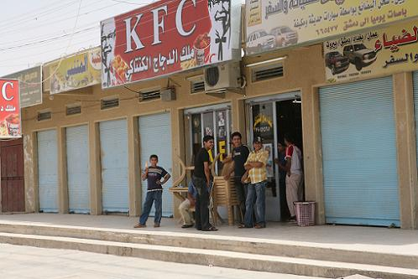
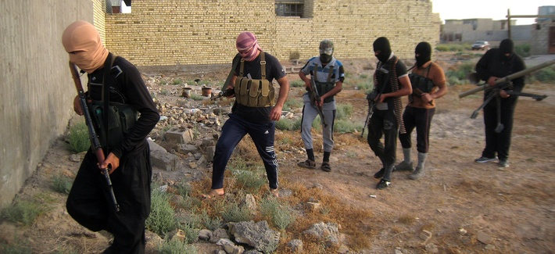
Fallujah 2005-2011
ISIS
30

Slide 31
Title Slide
Integration
United States Army Combined Arms Center

